Slide 1
Recommendation Engine Hackathon - Powered by IBM Cloud
By
Diwakar Channubhotla
Sathya Sai Kiran Dornipati
Aniket Goel
Pavan Kumar Peketi

Slide 2
Agenda
Objective and Problem Statement
Understanding Data Set
Our solution approach
Implementation Process
Apriori Inputs and Outputs
Conclusion

Slide 3
Objective To Build a robust recommendation engine for the Organization “Silara Retail” for their online retail portal.
Problem Statement
To help the business do better sales, the customers are recommended some of the items based on their shopping cart list. The customer is happy because he benefits from getting good deals for the products that they need, and the vendor is happy because he has more sales which in turn results in more returns.
https://datahack.analyticsvidhya.com/contest/build-a-recommendation-engine-powered-by-ibm-cloud/

Slide 4
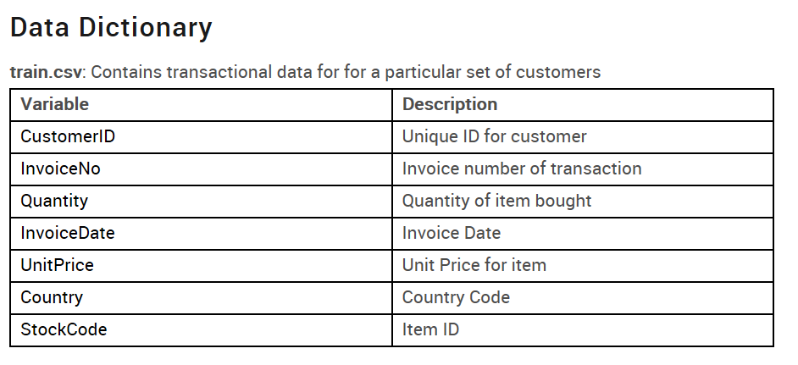
Understanding the Data set.

Slide 5
Our solution approach
To build a robust recommender engine that mines the data for patterns.
Items that are brought frequently together with some other items
Support , The of an item X, supp(X) is the proportion of transaction in the database in which the item x appears. It signifies the popularity of an item set.
Support(X) = number of transactions in which X appears / total transactions. Ranges from 0 to 1
Confidence , signifies the likely hood of item Y being purchased when X is already purchase.
Conf(Y -> X) = P(X | Y) / P(X). Ranges from (0 to 1)
Lift , The likely hood of item Y being bought when X is bought while taking into the consideration the popularity of Y.
Lift(X->Y) = P(X | Y) / P(X) * P(Y). If the value of the lift is greater than 1, it means that the item Y will be likely bought together with X.

Slide 6
Implementation Process
Import the dataset.
Data Preprocessing
Remove the redundant data.
Converting the invoice data into list of transactions.
Build the model
Provide the Apriori algorithm with the transaction data that is mined from the customer given data.
Supply the values for the parameters , like support , confidence .
Recommend the items based on the test data that have been provided by the customer.

Slide 7
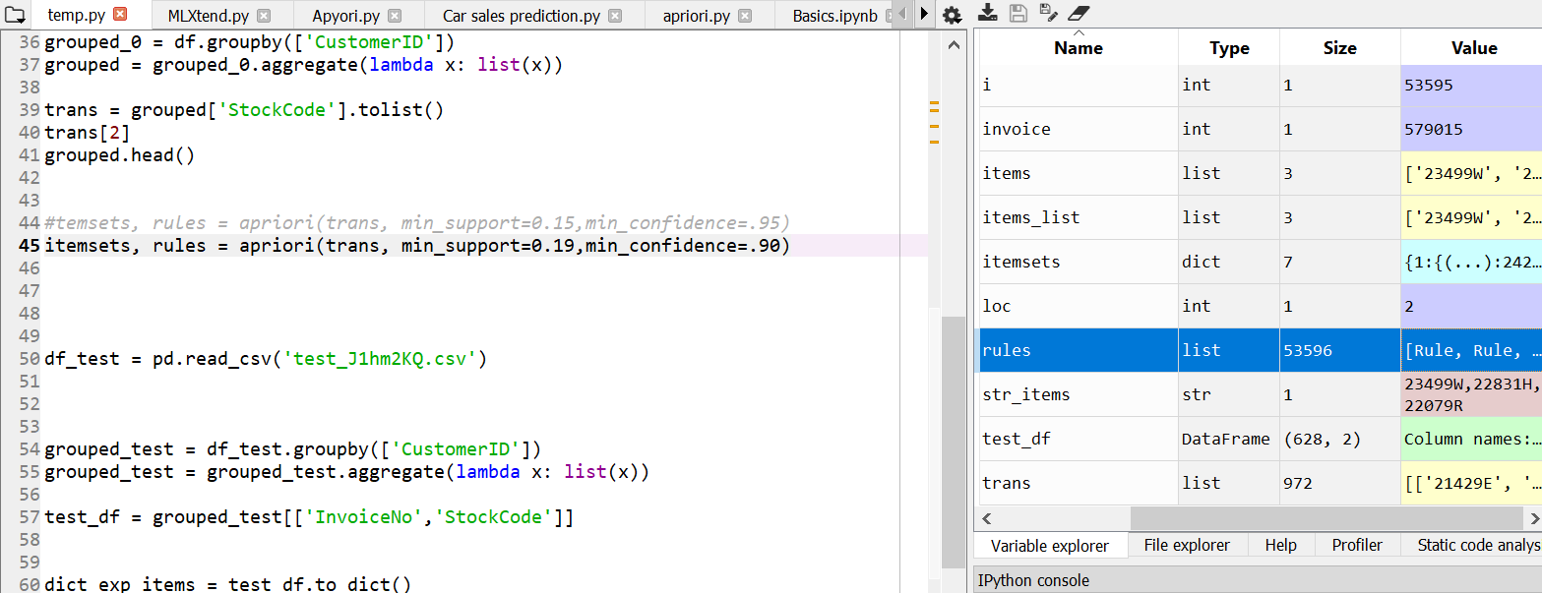
Apriori Inputs and Outputs.

Slide 8
Conclusion
The recommendation is done based on the 90% of confidence and 0.19 percent of the support.
Each customer is recommended one product for each product that he has brought.
The results are exported to a csv file , that contains Customer id and Recommended items for each Customer.

Slide 9
Q n A

